Slide 1










LINKLIST

Slide 2
LINKLIST
types of linklist
Algorithm
Code

Slide 3
LINKLIST
it is a linear data structure in which elements are accessed according to pointer address each element have address of other element.

Slide 4
TYPES OF LINKLIST
Singly linklist
Doubly linklist

Slide 5
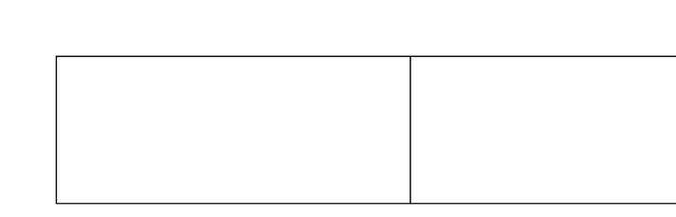
SINGLY LINKLIST
1. it has one-way data portion and one-way address it is also called singly.
Data portion
Node

Slide 6
DOUBLY LINKLIST
it has one-way data portion and two-way address; middle part is for back address from where it came doubly.
Pervious | Data | Next

Slide 7
ALOGRITHM
[TRAVERSING THE ELEMENT ACCORDING TO LINK LIST D IS THE NAME OF ARRAY LINK AND HEADNOTE IS NAME OF ARRAY]
STEP 1: - SET PTR START.
STEP 2: - REPEATE WHILE PTR # NULL.
STEP 3: - WRITE D[PTR].
STEP 4: - SET PTR = LINK [PTR]
STEP 5: - [END OF STEP 2 LOOP].
STEP 6 EXIT.

Slide 8
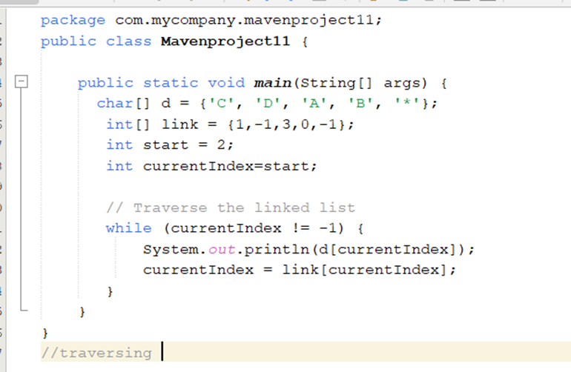

Slide 9
Advantages
Can grow or shrink easily – No need to fix the size in advance.
Easy to add or remove items – Can insert or delete anywhere without moving other items.
Saves memory for changing size – Doesn’t waste space like arrays.
Flexible – Can be used to make things like stacks and queues easily.

Slide 10
Disadvantages
Slow to find items – You have to check one by one from the start.
Uses more memory – Each item needs extra space to store the pointer.
Harder to use – Managing the connections (pointers) is tricky.
No direct access – You can’t jump to an item like in an array.

Slide 11
Real life example
Music Playlist – Each song points to the next song in the list. You can add or remove songs anywhere.
Imagine the items
Playlist: Song1 → Song2 → Song3 → Song4
Each song is a node.
Each node points to the next song.
[Song1 | Next] → [Song2 | Next] → [Song3 | Next] → [Song4 | Next] → NULL

Slide 12
THANK
You

